Slide 1
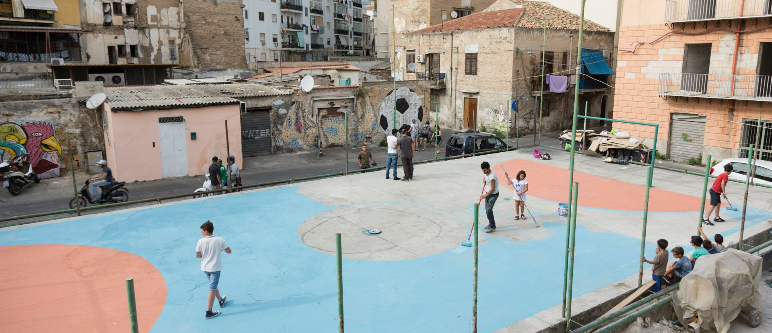
CASE STUDY
BORGO VECCHIO FACTORY
IN SHORT
STORY
IN FOCUS
‘Street art can become an extremely powerful tool of non-formal education to involve children and help them in expressing themselves but, at the same time, to get in touch with marginal contexts with strong social exclusion and involve people in a small-scale revolution based on beauty, sense of belonging and re-appropriation of common spaces.’¹
OPPORTUNITIES & CHALLENGES
GENERATING IDEAS
The act of drawing something that may not even exist is very important for kids living in a condition of closure. If they discover they can think what they want, and at least draw it on a wall, they will have made a key step towards their personal and collective freedom.
NEMO’S, street artist
Borgo Vecchio is an old neighbourhood in Palermo, southern Italy. It's a historical area where most families live in poverty, unemployment reaches 40% and access to education is extremely low. The district is hit by social unrest, due to an absence of public services and the high crime rate.
Ema Jons is a street artist from Milan province. He bumped into Borgo Vecchio by chance and here he began painting on the walls while learning about this place. One day he knocked on the door of our design lab PUSH asking us for a hand.
So we came up with Borgo Vecchio Factory¹: we launched a crowdfunding campaign² to fund creative painting workshops for children in the district making a video subtitled in 10 languages and creating perks inspired by Ema's graffiti. We involved Per Esempio NGO which contributed with its educators and organized the cycle of laboratories. We ended up collecting 8.000 € which allowed us to involve further street artists and to fund other interventions such as the football field recovery.
The kids attended an after-school programme to contrast drop-out based on drawing, creativity and the direct involvement in the graffiti making. The community has happily got involved in this little colourful revolution, proud of of the little artists' works that graced the abandoned spaces giving them a new identity. Alongside this, Palermitans rediscovered Borgo Vecchio and a new kind of alternative and responsible form of tourism was born, to discover this small open-air museum.
After its conclusion, Borgo Vecchio Factory can be said to have been a wonderful experience and its impact is still visible. Its story was told in a documentary that inspired a mini-series about how art changes cities³. However, it was only a drop in the sea and the neighbourhood's conditions are still critical. This is proof that such initiatives are key to trigger a spark but solving social issues in marginal contexts needs deep political will, long-term strategy and a targeted investment plan.
DEVELOPING & TESTING
IMPLEMENTING & FINANCING
GROWING & SCALING
CHANGING SYSTEMS
© Social Innovation Academy.
Author: Domenico Schillaci
Inspiration, sources, credits:
1) https://www.wepush.org/en/projects/borgo-vecchio-factory/
2) https://www.indiegogo.com/projects/borgo-vecchio-factory/x/7117127
3)
https://vimeo.com/ondemand/artforchange
Photo:
Courtesy of Mauro Filippi
For more social innovation examples, visit www.socialinnovationacademy.eu

