Slide 1
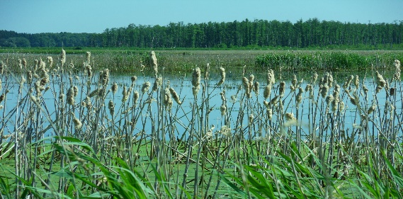
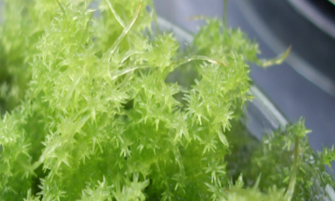
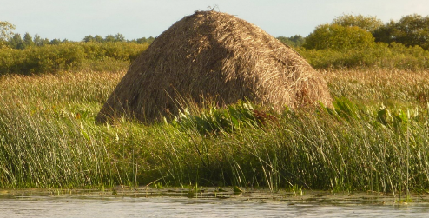
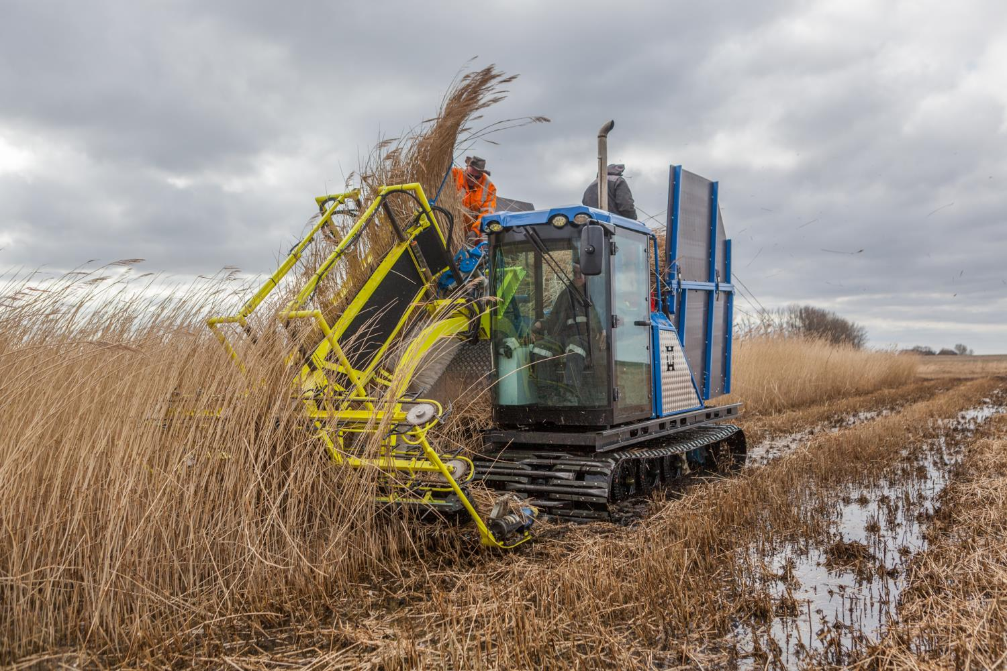
CASE STUDY
PALUDICULTURE
IN SHORT
STORY
IN FOCUS
Many peatlands have been drained to win land for agriculture. But drained peatlands are a major source of greenhouse gas emissions. Paludiculture, or the productive use of wet and rewetted peatlands¹, advances rewetting of peatlands in a social way: it makes farmers part of new solutions flowing from wet agriculture. The plants of wet landscapes provide inputs for regional value chains, as well as social and environmental values.
OPPORTUNITIES & CHALLENGES
GENERATING IDEAS
Peatland use:
it must be wet to be sustainable
GRETA GAUDIG, DIRECTOR
GREIFSWALD MIRE CENTRE
After the Fall of the Berlin Wall, a group of ecologists saw an opportunity for not only political but also socio-ecological transition: Rewetting the peatlands that had been systematically drained, ever since Frederick the Great and his land reclamation projects.²
Drained or damaged peatland release an estimated 5% of anthropogenic greenhouse gas emissions. The water being drained, land subsides, fires occur. Without water, mires – the kidneys of the landscape – cannot function to reduce the outflow of nutrients, such as nitrate, into rivers and coastal water, or to retain water improving local cooling and drought protection. The aquatic warbler is but one species that needs mires to have a home.
Using the analogy of agri- and sylvi-culture, paludiculture explores the use-options of plants growing in wet and rewetted peatlands or in constructed wetlands. Cattail, reeds, peat moss and sedges are examples of plants with yet underexplored or marginalized productive use: biomass for energy & horticulture, construction material for roofs or insulation, fodder for cows.
Getting your feet wet requires a change in mindsets and machines. For this deep transition in land-use to unfold its potential, we can think of paludiculture as an innovation mission: a large-scale, publicly supported effort in sustainability transition allowing farmers and others to develop new value chains³. And there is a need to balance this exploration with respect for marginalized traditional and indigenous practices of living with mires as well as for nature conservation without any productive use.
DEVELOPING & TESTING
IMPLEMENTING & FINANCING
GROWING & SCALING
CHANGING SYSTEMS
Authors: Rafael Ziegler and Christina Lechtape. Photos: Wendelin Wichtmann, Tobias Dahms, Greifswald Micre Centre. Source:
1) https://www.moorwissen.de/en/paludikultur/paludikultur.php
2) https://www.researchgate.net/publication/340092744_Paludiculture_as_a_critical_sustainability_innovation_mission
3) http://wrrl-info.de/docs/seminar56_ClearancePolicyRecommendations_12_9_BrusselsDeclaration_Final.pdf
For more social innovation examples, visit www.socialinnovationacademy.eu

