Slide 1
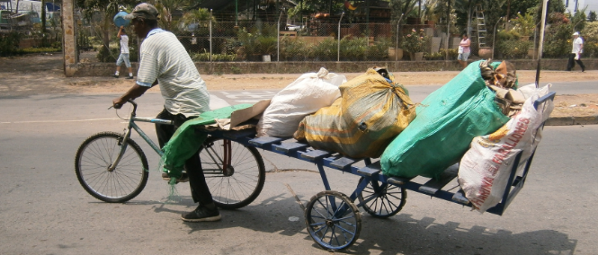
CASE STUDY
RECYCLING BICYCLE CART
IN SHORT
STORY
IN FOCUS
The Recycling Bicycle Cart was developed as part of a co-creation process to improve mobility in the solid waste recollection system, especially the working conditions and lives of waste pickers in urban areas of Latin America.
This low-cost technology has brought together local innovators, waste pickers and local authorities with the aim of strengthening the social inclusion of the most vulnerable group in society.
OPPORTUNITIES & CHALLENGES
GENERATING IDEAS
Co-creation brings people together for boosting innate creativity and capabilities into solving societal problems. It is a powerful tool for increasing empowerment and raising voices.
HÉCTOR JAVIER GARCÍA HIGUERA, INTEGRANT OF THE INTERNATIONAL DEVELOPMENT INNOVATION NETWORK
One of the most popular informal jobs in Latin America is that of waste picker. They have suffered from discrimination, laws against their work, and have to deal with the health and hazard risks involved in waste picking without proper education, equipment and regulation. Around 3,200 formal and informal waste pickers in the city of Cali (Colombia) face this reality.
However, in Cali, this represents an alternative for the integrates of the International Development Innovation Network (IDIN)¹, Plástico Infinito² and Fundación Tecnisólidos³. Together we have been working hand in hand with the waste picker community since 2015 on developing low-cost technologies for a better transport system and the recollection of recyclable materials. Our aim has been to improve their lives and working conditions.
Waste pickers were a key element in the design process. They identified the advantages and disadvantages of traditional wooden carts in co-creation workshops, participated in construction sessions and tested the bicycle cart. This offers the double functionality of use either with a bicycle or by hand.
With the participation of the municipality in 2019, we developed a lighter version and tested it with waste pickers in eight associations. It was able to carry up to 600 kg. Feedback from the associations was then translated into the design of the Recycling Bicycle Cart. It comprises a metallic structure, retractable handlebar and attachment system for any kind of bicycle. The future plan is to make this prototype available for 300 waste pickers.
With this process we want to strengthen the social inclusion of the most marginalised group in order to contribute to the construction of a sustainable waste management system in Cali.
DEVELOPING & TESTING
IMPLEMENTING & FINANCING
GROWING & SCALING
CHANGING SYSTEMS
Author: Héctor Javier García Higuera
Inspiration, sources, credits:
http://www.idin.org/
2)https://agenciadenoticias.unal.edu.co/detalle/article/trituradoras-de-plastico-facilitan-reciclaje.html
3) https://www.tecnisolidos.co/
Photo:
Courtesy of Héctor Javier García Higuera
For more social innovation examples, visit www.socialinnovationacademy.eu

