Slide 1

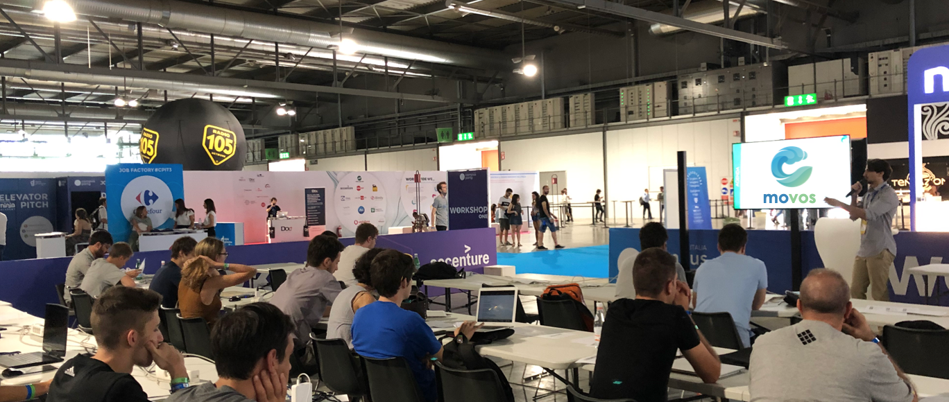


CASE STUDY
MOVOS
IN SHORT
STORY
IN FOCUS
MOVOS is all about one thing: engaging startup entrepreneurs in a working path to discuss how sustainability can positively affect the growth of their business and discover the role they wish to play in current societal challenges.
This is the MAXIMUM visual (photo / quote / logo area). Please use it ALL if you can by cropping your photo nicely, rather than leaving white space. We need a good enough resolution to be printed on A4 without ANY pixels visible, ideally min.1080 wide. Please be very careful not to move the boxes around. After your visual comes here, you can delete this frame.
Please use either a credit-free photo or a give the appropriate credit for the photo in the bottom right corner (see example).
OPPORTUNITIES & CHALLENGES
GENERATING IDEAS
MOVOS’ added value is to clarify the sustainability aspects of entrepreneurs’ current approach as well as help identify new business opportunities that could both be socially impactful and make business sense
CORRADO PATERNO’ CASTELLO, Founder
MOVOS’¹ is a pro-bono initiative that aims to empower entrepreneurs to foster the prosperity of their business while contributing to social and environmental challenges, thus paving the way for sustainability to become part of the enterprise culture. The idea behind MOVOS is based on the consideration that ‘it should be easier to “infect” founders of new businesses with the idea of sustainability than to rebuild the established corporate cultures of existing companies’². Often many start-up entrepreneurs are indeed not fully aware of the potential market opportunities that might exist for sustainability-oriented businesses. For this reason, MOVOS wants to highlight successful best practices in their respective industries and make them aware of the opportunities of sustainable business practices to meet customers’ needs, match investors’ expectations and provide social value to business.
In order to engage entrepreneurs in a mature and business-oriented reflection and support them in the integration of sustainability into their business model, MOVOS developed a tailored methodology based on 3 main steps: 1) analysis of the socio-economic context and of the current and potential impact of the business; 2) design of entrepreneurs’ sustainability vision and definition of the related objectives; 3) brainstorming and selection of the most viable solutions (that make business sense) to achieve the objectives.
MOVOS works with networks and enablers that are in close contact with entrepreneurs, such as incubators and accelerators. In 2020, MOVOS partnered with Startup Africa Roadtrip³ to train four startups from the network to define their social impact strategy, integrate it into their corporate identity and present it to investors during their pitch. The contribution helped the entrepreneurs clarify and reinforce their social mission, strengthen the founders’ and employees’ commitment and attract investors, especially the most social-impact
driven.
DEVELOPING
& TESTING
IMPLEMENTING & FINANCING
GROWING
& SCALING
CHANGING SYSTEMS
Author: Corrado Paterrno
Inspiration, sources, credits:
1) https://www.movos.it/
2) Sustainability Issues for Start-up Entrepreneurs – Hildegard Schick, Sandra Marxen and Jürgen Freimann
3) http://startupafricaroadtrip.com/
For more social innovation examples, visit www.socialinnovationacademy.eu

